Slide 1

The
ESSENTIALS
of Tres Dias
The Preamble
The Movement
The Method
The 4th Day
The Local Secretariat
Notes:
DEFINITION ESSENTIAL: A BASIC, INDESPENSIBLE NECESSARY ELEMENT…
MORE YOU STUDY ESSENTIALS, THE MORE YOU UNDERSTAND AND RESPECT THEM.
START WITH PREAMBLE…

Slide 2
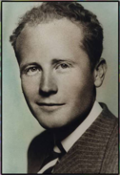
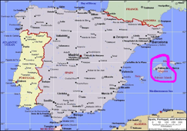
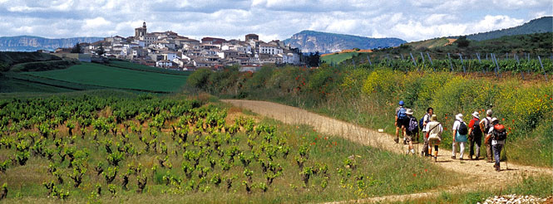
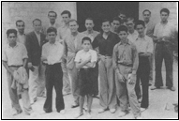

A bit of history
The roots of Tres Dias began in a small island off the coast of Spain.
Eduardo Bonin and a group of young men had a burden to revitalize the church after the Spanish Civil War.
They were preparing for a pilgrimage to Camino De Santiago (Way of St. James) in Spain, so they developed a week-long short-course in Christianity. It was eventually shortened to three days so more men could attend. Soon, Cursillo swept across Spain.
Notes:
Along came Eduardo Bonnin and some young men ---with a burden to revitalize the church after the Spanish Civll War. They met weekly to sltuayd . Met weekly to study and were preparing to go on a Pilgrimage across Spain.
The Camino de Santiago (the Way of St. James)-- large network of ancient pilgrim routes stretching across Europe --- END the tomb of St. James. Yearly, hundreds of thousands of people of various backgrounds walk the pilgrim’s footsteps.
The men Held week long seminars to prepare….Called seminar Cursillo de Christianadad, meaning in Spanish “Little courses in Christianity.
Leadership School with lectures on the culture of religion….Lay Led…..contained lectures called Rollos… First week, 1944
Eventually, shortened 3 days…. 70 years ago, it was not much different from the three days our candidates live and experience on weekends.
Today’s Tres Dias Essentials are virtually identical to the first Cursillo weekend held in 1944. Our TD weekends are short courses in Christianity, what we believe/why,,,We are all on a pilgrimage….to meet the Lord fresh new way…

Slide 3
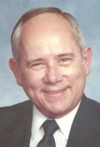
Cursillo came to the US in 1957 through through military bases in Texas.
First English-speaking Cursillo – 1961. Spread through the US.
David McManagal
David McManagal, a protestant, attended one. The Holy Spirit totally zapped him on Saturday. He was filled with a love he never expected to experience.
He was on fire. How can we bring this to Protestants The governing board finally gave permission to use the materials, and Tres Dias was born! First weekend 1972 in NY.
Notes:
Dave --- attended a Cursillo weekend 1970. In his own words….said, Holy Spirit totally zapped him on Saturday, and he was filled with a love he never expected to experience.
Dave was on fire, wanted to bring Cursillo to Protestants, make the materials non-denominational. Repeatedly asked for team manuals, pilgrim guides, and rector scripts ---He met with strong resistance.
After a year of trying and praying about it, one night, he simply gave up, and gave it all to God. The very next morning, the phone rang, and the leader of the Cursillo governing board called Dave, and said, “I will help you do this.”
Next few months he edited and revised the material to be non-denominational for this three-day weekend. He and the original team trying to come up with a name--- suggested “Three Days.” So… “Tres Dias.” CAME UP WITH THE CROSS PATTERN….
First weekend, Mid Hudson NY 1982 --- A few years later, came up with essentials.
He had no idea what a movement was started from his basement, making pilgrim’s guides and weekend materials on a broken down Xerox copier.
Now worldwide movement 101 chapters…REASON I TELL YOU THIS…to.see what a Holy Spirit led movement this is….

Slide 4
1.0 PREAMBLE ----Introductory statement that explains the document..
The TRES Dias Movement endeavors to bring Christians to a closer, more personal walk with their Lord Jesus Christ and encourage them to Christian leadership and Apostolic Action in their environments.
TRES DIAS is based on the principles, the method, and the teachings of the Roman Catholic Cursillo movement initially proposed by Eduardo Bonnin and his fellow Christians.
Each candidate goes through three phases of the TRES DIAS movement: the pre-weekend; the three-day weekend and the Fourth Day.
TRES DIAS is a Christian ecumenical movement.
Notes:
Preliminary statement that states the reasons for what follows. “We the people of the United States..” preamble to our constitution.

Slide 5

“The founders of the Cursillo movement saw a world of great need around them. They knew that the answer to the needs of the world had to be Christ and His Grace;
But, they saw Christians who did not live for Christ, and they saw a church that was ineffective and without life. They developed the Cursillo to meet part of this problem:

Slide 7

The main teaching of TRES DIAS is God’s unqualified love for each of us through grace.
It asks each member of the TRES DIAS community to grow in their personal piety, to study God’s Word and other Christian writings and to express their love for Christ in Christian Apostolic Action.
These three aspects of Christian growth are stressed in the cloistered environment called, “the weekend.” An invitation is issued during the weekend for each Pescadore to join a small group of his/her own choosing for continued support, prayer and encouragement.
KEY POINTS
Main teaching: God’s love through grace
Asks each member to grow in personal piety, study and Apostolic Action .
In the cloistered environment called ”The Weekend
Will be invitation to join a small group for continued support
Notes:
What about other writings?
Be discerning. Just because on a Christian bookstore under “religious” doesn’t mean it’s quality.. If it contradicts Christianity, toss out.
Look for reputable publishers
Do your homework

Slide 8

In order to ensure consistency and stability within the TRES DIAS Movement, there must be certain essential aspects to which all TRES DIAS organizations conform.
These Essentials fall into two categories: those which are quantitative and those which are qualitative in nature.
Quantitative vs. Qualitative
The Numbers
3 days
72 continuous hours
15 Rollos
5 meditations
2 table chapel visits
The Quality
Adherence to the Essentials
Team meeting prep
Rollo coaching
Organization

Slide 9


It is the intent of TRES DIAS to use both of these categories as criteria for chartering local secretariats.
It should therefore be the policy of local secretariats to comply with these Essentials.
Policies of local secretariats which deviate from these Essentials must be reviewed on an individual basis and are subject to the approval of TRES DIAS.

Slide 10

Pop Quiz --- True or False?
It is essential that a candidate must be sponsored.
It is essential that a husband go before his wife.
It is essential to have palanca on a weekend.
It is essential that we recite the meditation Page 14 before each Rollo.
It is essential that Thursday night after chapel is in silence.
It is essential that a serenade is held on Saturday night.
It is essential that we collect letters for the candidates from family and friends.
It is essential that a forgiveness (cross ceremony) is on every weekend.
It is essential that team stays on the campground all weekend.

Slide 11



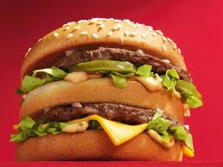

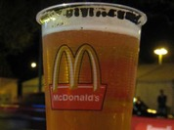
Regarding consistency and stability ….
Tres Dias is sort of like a “franchise…”
We sign a contract with & are chartered by TDI
We are authorized to use all their materials
We agree to abide by the Essentials
And we bear the name and the brand of Tres Dias
We have freedom to have our varied traditions….
Traditions are the add-ons--like the McBeer in Germany,
Curds and Gravy at Burger King
Notes:
NOT PART OF THE ESSENTIALS, BUT EXPLAINS….
McDonald’s logo is the most recognized symbol in the world. What are some others?
Burger King: Russia, curds and gravy with French Fries, Thailand Chicken McNuggets with Rice
Each community adopts their own style, method and traditions. Some have Chas, others call them Auxiliaries or Auxes…Some are simple weekends, no frills, others more frills….
It’s all okay.. As long as we adhere to the Essentials. Essentials say team must meet prior to weekend…but doesn’t outline how the team meetings are held.
Each weekend has a script. Essentials don’t outline what is in the rector’s script, but they outline what must be covered on a weekend, how and when the essential things must be done.
We must include the Essentials and follow them exactly. OR ELSE we cannot call ourselves Tres Dias.

Slide 12
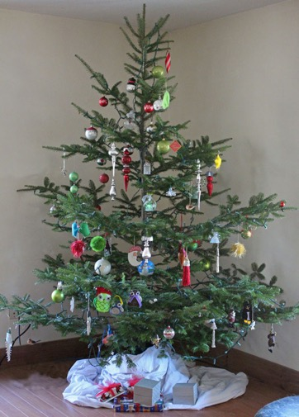
Bonnin used the example of the Christmas Tree, ornaments are essentials -- everything needed to put on a weekend.
Candidates be sponsored for all three phases
It’s a weekend living in community
Cloistered weekend
Carefully planned activities
Group dynamics
Silent Retreat Thursday night
Lay-led with Clergy participation
SDs must be qualified teach/counsel
Rector a lay person
Team be a spectrum of denominations
Team meets to learn weekend
  dynamics & evaluate all Rollos
15 Rollos, one talk in 15 parts
Rollos follow TDI outlines
Discussions after each talk
Table chapel visits
Holy Communion each day
Schedule allow for informal time
Apostolic Hour/presentation crosses
Closing
Our Challenge
Notes:
.
Eduardo used a word picture of Christmas tree….The tree represents the essentials, all that is really needed to present the concepts of the weekend.
He was concerned that our God given creativity and enthusiasm might impact the real meaning
Still our challenge today
That’s why it’s important to know essentials and understand principles behind them…

Slide 13
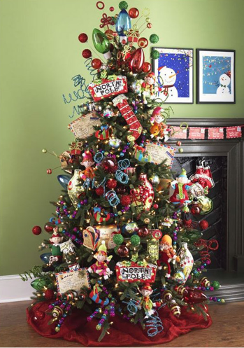
Send off
Palanca skits
Bed/table palanca
Posters/Art projects
Prayer tokens
Group photo
Singing DeColores
Theme banner
Worship
Chapel Times
Under the Blood
Foot Washing
Via Dolorosa marketplace
Forgiveness Ceremony Kitchen Skits & jokes
Readings & Prayers
Worship
Palanca letters
Serenade
Along come traditions – they vary by community
Send off
Palanca skits
Bed/table palanca
Letter palanca
Posters/art projects
Prayer tokens
Group photo
Singing De Colores
Theme , song, banner
Chapel Times
Under the Blood
Foot Washing
Via Dolorosa
Abrazzo Communion
Forgiveness Cross Ceremony
Chapel dramas
Kitchen Skits & jokes
Readings & Prayers
Pilgrim’s Guide, page 14
Worship
Serenade
Mananita, agape Fea
Stations of the Cross
Traditions give flavor, make us unique.
Essentials keep us focused on the basics, remind us to maintain balance, not overload the tree…
Notes:
TRADITIONS WHAT MAKES US UNIQUE…
They are wonderful, uplifting, God-honoring and fun but the essentials keep us focused, remind us not to load weekend up so much we can barely see the tree.
We have the essentials to keep us focused on the basics ----
People come along and add ornaments to it, traditions---they wonderful, uplifting, God-honoring and fun---MAKE US UNIQUE, but …..if we’re not careful we load it up so much, we can barely see the tree.
We have the essentials to keep us focused on the basics of why we we are here. TDI, governing body, keep our charter, teach essentials.

Slide 14
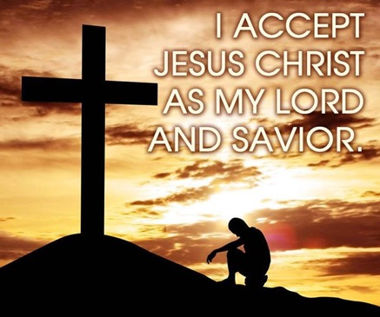
Ultimate objective: To strengthen and extend the Body of Christ
2.0 THE ESSENTIALS OF THE MOVEMENT
TRES DIAS is a Christian movement.
The ultimate objective of the TRES DIAS Movement is to strengthen and extend the Body of Christ. No TRES DIAS organization shall change the teachings or practices of the TRES DIAS Movement to accommodate the participation of non-Christians.
For the purpose of these Essentials, “Christian” is intended to refer to those who are seeking a closer relationship with Jesus Christ as their Lord and Savior.
For those seeking a closer relationship with Christ.
Notes:
TD is for Christians
Not for the curious
Must agree with our statement of faith

Slide 15
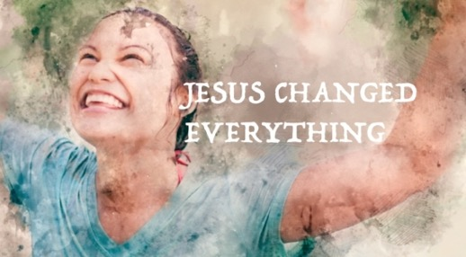
Tres Dias is a Movement
2.0.1 Tres Dias is a Christian “movement.”
  Definition: a group of people working together to advance their shared philosophy/ideas.
  Tres Dias is designed to move people from where they are to where God wants them to be
  Teams are to be vessels of the Lord for bringing this about.
Notes:
We are here to be vessels of the Lord for bringing this about.
Candidates and team are: a group of persons who come together for three days to share friendship, personal contact, and joy.
All TRES DIAS organizations shall actively seek the participation of persons from all the Christian denominations in their environment.
All TRES DIAS organizations shall stress those things which the Christian denominations have in common and respect those things which are different.
Preamble states: The TD movement endeavors to bring Christians to a closer, more personal walk with their Lord Jesus Christ and encourage them to Christian leadership and apostolic action in their environment

Slide 16

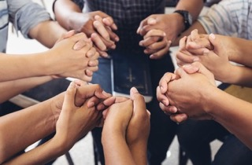
2.0 THE ESSENTIALS OF THE MOVEMENT
TRES DIAS is a Christian ecumenical movement.
All TRES DIAS organizations shall actively seek the participation of persons from all the Christian denominations in their environment.
All TRES DIAS organizations shall stress those things which the Christian denominations have in common and respect those things which are different.
All TRES DIAS organizations have the duty and the authority to protect the TRES DIAS ecumenical structure.
Ecumenical
Participation from all Christian denominations (Bible based)
Stress what we have in common
All communties have the duty to protect the ecumenical structure
Notes:
Ecumenical - Duty to protect ecumenical structure
Ecumenical – different church traditions
Open to ALL Christian denominations --- (Some call themselves Christian – like Mormons)
Stress what we have in common/respect differences
We may have different worship traditions, ways our churches function
We stress what we have in common --- Jesus and the sovereignty of the Bible

Slide 17

Lay Led
2.0 THE ESSENTIALS OF THE MOVEMENT
3. TRES DIAS is a lay led movement.
TRES DIAS is a lay led movement; however, the active participation of the clergy is both essential and to be encouraged
4. TRES DIAS is a non-profit movement.
TRES DIAS organizations should pursue prudent fiscal policies. They shall avoid accumulating assets beyond what is required to carry out their part in the TRES DIAS Movement.
Lay-led: Teams, Professors
Secretariat leadership, all lay people
Clergy – Clergy Rollos, spiritual counsel, serve communion, all SDs are considered ”clergy.”
Non-Profit
Savings (war chest) is invested back into the ministry for conducting weekends.
Notes:
Lay-led, makes us unique
Non profit, sometimes confusing….
Doesn’t mean can’t have savings…
Money taken in is re-invested in the ministry
All communities encouraged to have a war chest..

Slide 18


Essentials 2.5
5. The TRES DIAS movement shall not assume the role of a denomination.
TRES DIAS is not a church-substitute; rather it encourages Christians to worship and serve in their home congregations, as leaders.
TRES DIAS is not a service organization.
The Tres Dias movement encourages worthy projects. Tres Dias organizations shall limit their activities to those related to carrying out the Tres Dias method.
We are not a church substitute
  Why we don’t do baptisms
We aren’t a service organization
  We don’t donate to other ministries
  Can we mention them in newsletters? Yes, with discretion…
  But we don’t use mailing list for other than Tres Dias communication
Notes:
Not a substitute for local church
Communion only sacrament conducted on a weekend. Why we don’t do baptisms
Occasionally someone makes a commitment or recommitment to Christ.
As exciting as that is, we can’t deprive the family and loved ones to share such an important part of this step of faith.
Word got around that we did baptisms, what would some of the pastors think? Even more skeptical about Td. Better yet, team and sponsors attend the baptism at their local church….celebrate.
NOT SERVICE ORGANIZATION….Secretariat only encourages activities that carry out the TD Method. We encourage Pescadores to be involved in other ministries, but we can’t share our mailing lists….for someone to promote their worthy cause.
Can you announce an event at a meeting you need volunteers? It’s up to the rector, but you can’t put out a donation box or have a mailing list sign up. That’s what this means.
And NCTD doesn’t donate to other ministries or have fundraisers, other than to support the Tres Dias ministry.

Slide 19




3.0 THE ESSENTIALS OF THE
TRES DIAS METHOD (cont)
The three sequential phases of an individual’s involvement shall be: The Pre-Weekend phase, the Weekend phase and the Fourth Day phase.
The objective of the Pre-Weekend phase is to prepare individuals for participation in the Weekend.
The purpose of the Weekend, in terms of the method, is to prepare individuals for effective participation in the Fourth Day.
.
Weekend
  Purpose is to prepare the individual for the Weekend
  Sponsoring
  Team meetings
  Purpose is to prepare the individual for the 4th Day
  Rollos, Meditations
  Activities
  Purpose – to continue living Piety, Study and Action through participation in Secuelas and Reunion Groups
Pre-weekend
Fourth Day

Slide 20

3.1 THE PRE-WEEKEND PHASE
That the candidate be sponsored for participation in all phases of the TRES DIAS Movement, rather than just the Weekend.
That candidates be sponsored by a member of the chartered TRES DIAS community or a similar community approved by TRES DIAS.
That candidates have a desire for a closer relationship with Jesus Christ as their Lord and Savior.
Candidates sponsored for all three phases.
By a member of a chartered TD community.
Candidates desire a closer relationship with Christ.
Notes:
TD website has a list of ministries approved by TRES DIAS

Slide 21
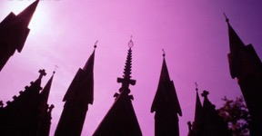

3.1 THE ESSENTIALS OF THE PRE-WEEKEND PHASE
That candidates be accepted from all Christian denominations.
That candidates be at least 21 years of age. However, if a local secretariat, using its best judgement, finds a sound and compelling reason, (such as spouse of a Pescador, or military personnel) it OCCASIONALLY, on a case by case basis, may accept a candidate who at least 18 years of age.
That candidates have not previously made a TRES DIAS weekend or similar experience recognized as equivalent by TRES DIAS.
Notes:
Occasionally someone has gone through a Walk to Emmaus or Cursillo years ago.
They don’t go through TD.
Come back and serve and experience all over again.

Slide 22

1. That the weekend have the following characteristics:
It is a weekend of living in Christian community involving a combination of carefully developed activities and teachings which are meant to lead to a fuller personal commitment to Christ.
It embodies personal witness, but it is not a revival meeting.
It employs group dynamics, but it is neither sensitivity training nor group therapy.
3.2 Essentials of the Weekend Phase
We live in Christian community for three days.
The activities and teachings are carefully developed.
The Rollos are personal witness
We aren’t there for group therapy.
Notes:
Group therapy --- People will share their burdens/challenges, not our place to advise
Not time to give advice or fix
If you see this happening with candidates --- redirect

Slide 23
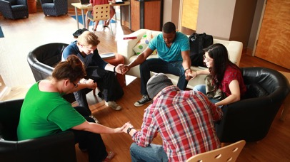


D. It employs theological instruction that encourages the candidate to study his/her own Christian beliefs, but it is not a course in doctrine.
E. It includes a period of silent introspection, but it is not a retreat.
F. It is a renewal experience for Christians and is not necessarily a conversion experience.
Not a course in doctrine
Not a normal “retreat.”
Spiritual renewal experience
Occasionally a conversion, but not the goal.
Notes:
Not a course in doctrine ---
We can disagree on ways to worship, etc. but we all agree on the sovereignty of God and living a life of piety, study and action.
We don’t get into theological discussions, and if you see that happening at the table, or in the dining hall, try to redirect the conversation.

Slide 24



3.2 THE ESSENTIALS OF THE WEEKEND PHASE
G. It asks for basic faith, openness and a seeking attitude on the part of the candidate, but involves a great amount of dedication, prayer and careful planning on the part of the team.
H. It is an encounter with the Holy Spirit. However, TRES DIAS is not a “charismatic” movement.
I. The weekend is a tool of God, not an end in itself. The weekend will not produce a permanent effect without Fourth Day activity.
Faith, openness, seeking attitude from the candidates
Team is dedicated, prayerful and plans carefully.
Weekend is a TOOL OF GOD!
Notes:
Not Charismatic
Define charismatic, simple as possible: emphasize healing gifts/speaking tongues.
Not something we do on a weekend.
Seen this happen. Candidate starting praying over another candidate in tongues.
Also, if it happens, need to redirect them…
TOOL OF GOD --- WITHOUT 4TH DAY, WEEKEND BECOMES A SWEET MEMORY…

Slide 25

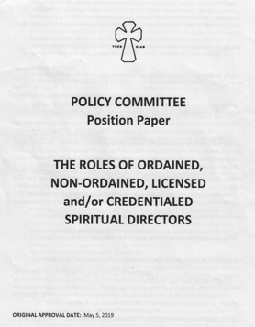
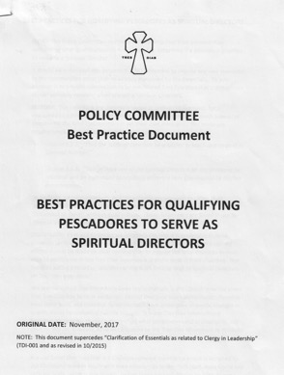
3.2 THE ESSENTIALS OF THE WEEKEND PHASE
That the Spiritual Directors be qualified to teach and counsel in spiritual matters by his/her church or denomination.
That at least one of Spiritual Directors on the Weekend be ordained, licensed or credentialed and authorized to regularly celebrate Holy Communion by his/her church or denomination.
  For the purpose of these Essentials “clergy” is intended to refer to those persons qualified to serve as Spiritual Directors.
Tresdias.org
”Resources”

Slide 26



3.2 THE ESSENTIALS OF THE WEEKEND PHASE
  That men and women attend separate weekends. The Spiritual Directors are exempted.
  That team members represent a spectrum of Christian denominations. (ecumenical)
  That team members have previously made either a TRES DIAS Weekend or a similar experience recognized by TRES DIAS.
  7. That the Rector be a lay person and be responsible for all aspects of the weekend, under the authority of the local sponsoring secretariat.
Rector is a lay person
The rector: Leads, guides, trains the team, works closely with the Secretariat. Rectors meet qualifications, are chosen for their spiritual maturity and teachable spirits.
Notes:
Rector Notes:

Slide 27




8. That the team meet prior to the weekend to:
Promote community
Receive instruction
Critique all Rollos
That the TRES DIAS weekend be an intensive three-day program lasting approximately 72 hours.
Notes:
All Rollos – even SD Rollos
Here’s why:

Slide 28
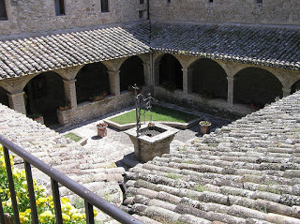
Essentials 3.2
10. The team and candidates live in a cloistered environment for the entire weekend.
(cloistered means “enclosed space”)
Cloister means: “Secluded, sequestered, protected”
As far as facilities permit, weekends are held in a cloistered space where team and candidates are insulated from the pressures and distractions of the outside world…
Before you agree to serve, you are asked if you can commit to being on the campground/facility for the entire weekend.
From Latin, claustrum, “enclosed space.”
Part of the monastery the general public could not enter. For prayer, study and contemplation.
It is so important that TDI created a position paper for more clarification….
Notes:
A cloister (from the Latin, claustrum, “enclosed space”) part of the monastery that the general public could not enter.
As far as facilities permit, weekends are held in a cloistered (enclosed) space where team and candidates are insulated from the pressures of everyday life and distractions of the outside world.
Before you commit to serve, you are asked if you can commit to being on the campground the entire weekend…
All team members--- including Spiritual Directors, are to be on the campground the entire weekend…The only exception is the Store Room Cha
** Our community no one is permitted to join the weekend after the chapel visit on Thursday evening.** If you go home sick, you can’t come back…
*** We ask team and candidates to make it an “unplugged weekend…” not use your cell phone.
Cloister/sacrifice/consecrating ourselves to the LORD --- CLOISTER OF THE HEART SO IMPORTANT POSITION PAPER ON IT…

Slide 29
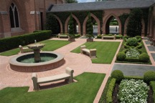
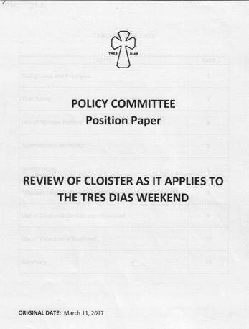
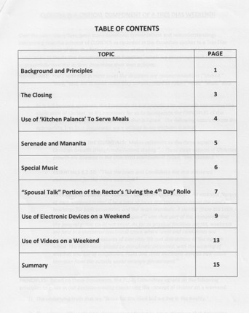
TRESDIAS.ORG
“Community Resources”
”Position Papers & Best Practices”

Slide 30
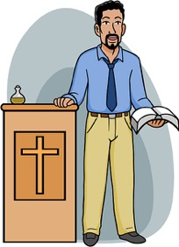





3.2 THE ESSENTIALS OF THE WEEKEND PHASE
That lay-talks not be given by clergy, and Spiritual Director talks not be given by a lay person.

Slide 31
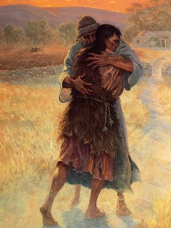
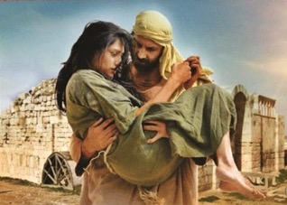
3.2 THE ESSENTIALS OF THE WEEKEND PHASE
    That the weekend begin in the evening with the following agenda:
    Introduction given by the Rector
    Start silent retreat, to end after chapel the next morning
    KNOW YOURSELF meditation, given by clergy
    PRODIGAL SON meditation (or alternatively, on a women’s weekend, the Hosea-Gomer account as recorded in Hosea 1-3, or the account of the woman caught in adultery, as recorded in John 8:1-11) given by clergy.
Notes:
Meditations --- The meditation invites the candidates to become aware of themselves, to risk a look inside. To ask themselves, “Who am I?” And Whose am I?
To understand that….we get lost when we are filled with self and seek our own way….
No matter how far we wander from Him, the Father waits to welcome us home.
Hosea/Gomer --- message of his undying love – how God forgives the unfaithful.

Slide 32


Weekend Phase
Silent introspection….
The night of purposeful silence can seem foreign and uncomfortable.
What is the value of it? Do we need it?
Silence takes the candidate out of the world, time to self-examine, hear from the Lord.
Silence prepares the candidate for Friday.
Notes:
Weekend must begin with night of silence to end after chapel, next morning..
Why silence? Thursday night: Know thyself meditation: Self examination.. who you really are….are you wearing masks?
Prodigal/Hosea story:, God seeks our return to him. Night of silence prepares for Friday…
Night of silence takes the candidate out of the world. For the team too
We are inundated with noise
Allows candidates and team to hear God’s voice
For introverts….a lessens the need for them to talk, allows them to adjust to the “intense” weekend
For extraverts, quiets their hearts, good discipline –
After team meeting on Thursday, be examples

Slide 33

  13. That the first day of the weekend have the following agenda:
      The THREE GLANCES OF CHRIST meditation, given by clergy
      The IDEALS Rollo, given by a lay person
      The GRACE Rollo, given by clergy
      THE CHURCH Rollo, given by a lay person
      THE HOLY SPIRIT Rollo, given by clergy
      The PIETY Rollo, given by a lay person
      Ideals is the only talk that cannot mention God or church. It should be give by a seasoned team member.
Notes:
3 GLANCES OF CHRIST….. WHERE each candidate hears the invitation of Christ to trust Him as Lord, and to be His disciple.
Ideals: only Rollo that doesn’t mention God, Jesus or church….difficult Rollo, give it to a seasoned team member
Piety means devotion

Slide 34


3.2 THE ESSENTIALS OF THE WEEKEND PHASE
That the second day of the weekend have the following agenda:
The FIGURE OF CHRIST meditation, given by clergy
The STUDY Rollo, lay person
The SACRED MOMENTS of GRACE Rollo, clergy
      Followed by Holy Communion ***
The ACTION Rollo, given by a lay person
The OBSTACLES to GRACE Rollo, given by clergy
The LEADERS Rollo, given by a lay person
15. That chapel visits by each table occur the afternoon of the second day.
Some communities call this the “We Prayer.”
When candidates pray with each other outside the Rollo room.
Notes:
FIGURE OF CHRIST….. This meditation answers the question: “Do you know Christ, or do you only know about Him?”
ONLY TIME COMMUNION IS specified.
Table Chapel Visits --- often called We Prayers…
ONLY TIME CANDIDATES PRAY TOGETHER OUTSIDE THE ROLLO ROOM
VERY POWERFUL, MEANINGFUL

Slide 35


That the third day of the weekend have the following agenda:
          CHRIST’S MESSAGE TO THE PESCADORE meditation, given by clergy
          The ENVIRONMENTS Rollo, given by a lay person
          The LIFE IN GRACE Rollo, given by clergy
          The CHRISTIAN COMMUNITY IN ACTION Rollo, given by a lay person
          The REUNION GROUPS Rollo, given by a lay person
          The LIVING THE FOURTH DAY Rollo, given by a lay person – most often the Rector
          The Apostolic Hour
          The Closing
Notes:
CHALLENGES THE PESCADORES TO RE-ENTER EVERY DAY LIFE WITH THE ASSURANCE THAT CHRIST IS WITH THEM

Slide 36

One continuous talk in 15 parts
Not random, there’s a logical progression
All build on each other
Each day is an entity, emphasizing different things
Notes:
Not part of the Essentials --- Deeper Dive

Slide 37


The Rollos
CLERGY TALKS: present the teaching of living a life in grace.
    Grace, Holy Spirit, Sacred Moments, Obstacles to Grace, Life in Grace
LAY TALKS (Rollos) illustrate, through the Rollista’s experience, how it is possible to live the life in Grace.
  Friday – What the candidate should be in the life of grace.
    (Person with ideals, who’s involved in church, who’s fully devoted to Christ
  Saturday – What the candidate must do in the life of grace
    (study, take action, lead/influence)
  Sunday – How to maintain the life of grace
  (Influence your environment, serve in community, belong to a sharing (reunion) group, & persevere in the Fourth Day….(Usually the RECTOR TALK)
  Best Practice: KEY POINTS AND TAKEWAYS OF ROLLOS
  available on the TDI website under “Resources.”
Notes:
ESSENTIALS OUTLINE ROLLOS AND THE ORDER GIVEN….
One talk in 20 parts
Each builds on the other…

Slide 38
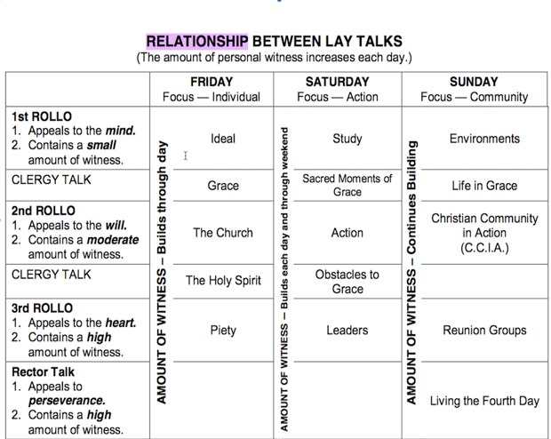


One Continuous Rollo, One talk in 15 parts
First talks, low key & safe, appeal to the MIND, understanding.
Second to the WILL, what actions do we need to take?
Third to the HEART, dedicate ourselves to Christ and his work.
Messages build each day.
Weekend touches candidates on ALL THREE LEVELS
Notes:
toThe Rollos are not a random series of talks. Logical progression
Each day has a specific theme and style. One talk 15 parts, add meditations, 20 parts
The first talks of day are low key and safe. They don’t challenge the candidates to make any changes. Messages build each day…..
The first talks of the day appeal to the mind, understand what it is to be a Christ follower. Second to the will, what actions do we need to take/third to the heart, dedicate ourselves to Christ and his work.
The weekend touches the candidate at all three levels.
Community building occurs during the table discussions after the talk…
ESSENTIAL THAT TABLE DISCUSSIONS FOLLOW EACH Rollo except Rector talk. WHAT SAID AT TABLE MORE IMPORTANT THAN PROF.
Rollos have time limits….speaker goes over, takes away from discussion

Slide 39

3.2 THE ESSENTIALS OF THE WEEKEND PHASE
Key Points
Table Chapel Visits – “we prayer” must be on Saturday and Sunday.
Table Discussions are essential.
Rollos/Meditations follow the outlines provided by TDI.
Communion offered each day
17. That chapel visits by each table occur the third day, preferably in the morning.
That table discussion follows each Rollo except the FOURTH DAY.
That all Rollos and mediations follow the dynamics and outlines authorized by TRES DIAS.
20. That the team and candidates have the opportunity to celebrate Holy Communion each full day of the weekend.
Notes:
Communion offered each day
Only required after Sacred Moments of Grace

Slide 40


3.2 THE ESSENTIALS OF THE WEEKEND PHASE
That a diversity of environments and viewpoints must be attempted in planning the weekend itself and in forming the tables.
That the freedom of self-determination of
  each candidate be respected.
That the lay Rollos be informal talks of a witnessing or sharing nature.
Notes:
Diversity of viewpoints..
New thought --- group tables by geographic regions, easier to connect
Informal talks – not teaching or preaching.
FREEDOM OF SELF DETERMINATION -- TALK ABOUT THAT NEXT SLIDE

Slide 41

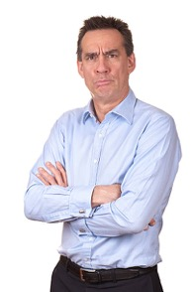


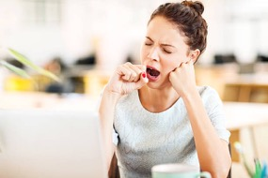

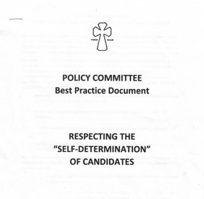


Freedom self-determination? What is that?????

Slide 42


Find Position Papers and Best Practice Documents – under “Community Resources”
Tresdias.org

Slide 43



3.2 THE ESSENTIALS OF THE WEEKEND PHASE
That a friendly creative Christian environment be
developed and fostered during the TRES DIAS weekend,
as opposed to a coercive or manipulative environment.
That the schedule allow time for informal personal
contact among the team and candidates.
26. That the Closing be as well prepared as other activities
of the weekend.
That the sponsoring secretariat encourage the
community to participate in the weekend through
spiritual and service Palanca.
Notes:
Informal Personal Time = BREAKS – BREAKS ARE AN ESSENTIAL, BUILD THEM INTO SCHEDULE
Spiritual palanca – prayer
Service palanca --- hands on assistance to candidates
Clean up after weekend
Supplies

Slide 44



3.3 THE ESSENTIALS OF THE FOURTH DAY PHASE
The Pre-weekend and Weekend phases are only a prelude to each individual’s Fourth Day.
1. Reunion Groups
That local secretariats encourage Pescadores to participate in Reunion Groups.
That local secretariats utilize the form of the reunion group known as “The Working Reunion Group,” to carry out the activities of the TRES DIAS Movement.
Secretariat Board:
The ”working reunion group.”
Serving together for God’s glory!
Rewarding and fun!

Slide 45
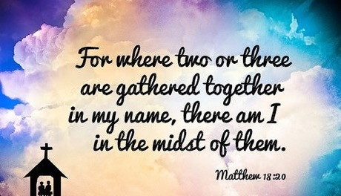
3.3 THE ESSENTIALS OF THE FOURTH DAY PHASE
Secuelas
A. That local secretariats sponsor regularly scheduled Secuelas; preferably at least once each month.
B. That each Secuela include an opportunity for Pescadores to participate in the form of reunion group known as ”The Floating Reunion Group.”
C. That each Secuela include a “Fourth Day Talk.”
A 4th Day talk --- from a person or couple who have been living their 4th day for six months or more and share how they’ve grown in the Lord since their Tres Dias experience.
Notes:
FLOATING REUNION GROUP --- DISCUSSION AT THE TABLE, PREFERABLY MIX PEOPLE UP
FOURTH DAY TALK --- NOT A RECAP OF THE WEEKEND, BY A NEW PESCADORE…HOW WONDERFUL IT WAS
WHAT HAS YOUR FOURTH DAY BEEN LIKE SINCE THE WEEKEND? HOW HAS YOUR LIFE BEEN IMPACTED BY TRES DIAS?

Slide 46


4.0 THE ESSENTIALS OF THE LOCAL SECRETARIAT ORGANIZATION
The function of the local secretariat is to conduct an effective program in accordance with the TRES DIAS Method.
That each local secretariat have a document, approved by its membership, describing its structure and operating procedures.
Notes:
DOCUMENT, POLICIES AND PROCEDURES

Slide 47

4.0 THE ESSENTIALS OF THE LOCAL SECRETARIAT ORGANIZATION
That the members of a local secretariat have completed a TRES DIAS weekend or a similar experience recognized by TRES DIAS.
All Pescadores of the TRES DIAS Community, whom the local secretarial claims to represent, must be eligible to serve as voting members and officers of the secretariat, providing they agree to meet, uphold and follow the qualifications as outlined in the local community’s Constitution and By-laws.
And TDI Qualifications for Community Leadership

Slide 48
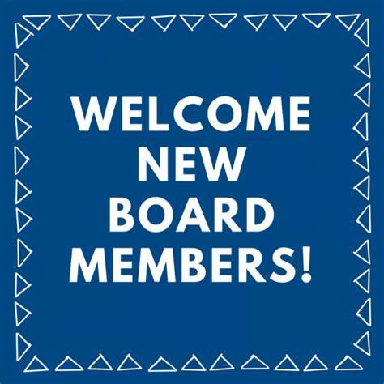
4.0 THE ESSENTIALS OF THE LOCAL SECRETARIAT ORGANIZATION
That the local secretariat have a plan for the periodic election of new members.
The local secretariat must be the sole sponsor of a TRES DIAS weekend held in its community.
Each local secretariat must sponsor at least two TRES DIAS weekends a year. For the purpose of charter, this requirement may be waived by TRES DIAS.
Periodic elections
Must be sole sponsor
Two weekends a year

Slide 49

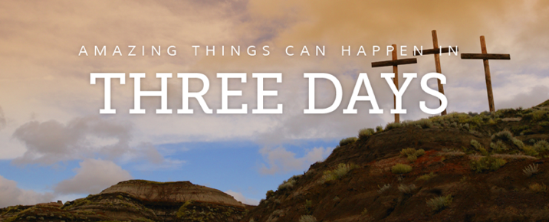
Thank you for joining us!
Notes:
Encourage reunion groups
Local secretariats WORKING REUNION GROUP
Local secretariats sponsor regularly scheduled SECUELAS
Floating Reunion Group
Fourth Day Talk
Each Secretariat have operating documents
All members completed a weekend recognized by TD
All Pescadores eligible to serve
Periodic election
Each must sponsor at least TWO weekends a year unless waived

